Slide 1
Communication and Networks
Chapter 6

Slide 2
Communication
A process in which one computer transfer data, instruction and information to another computer.
Communication required a device that initiates the transfer (sending device) that converts the signals capable of being carried by a communication channel.
Communication device that receives the signals converts them into a form understood by a receiving device

Slide 3
Communication Channel
Which is the communication path between two devices.
Composed of one or more transmission media.
Transmission media is consist of materials or techniques capable of carrying one or more signals.

Slide 4
Physical transmission media
Touchable materials used in communications
Include twisted-pair cable, coaxial cable and fiber optic.
Typically used in buildings and grounds.

Slide 5
Twisted-pair cable
Consist of two separate insulated copper wires that are twisted together.
The wires are twisted together to reduce noise which is electrical disturbance that can degrade communication.

Slide 6
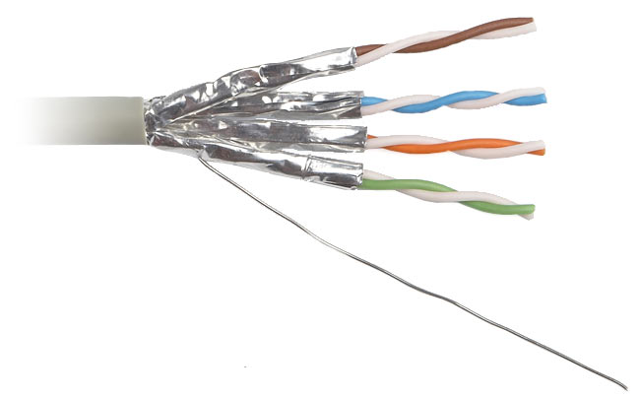
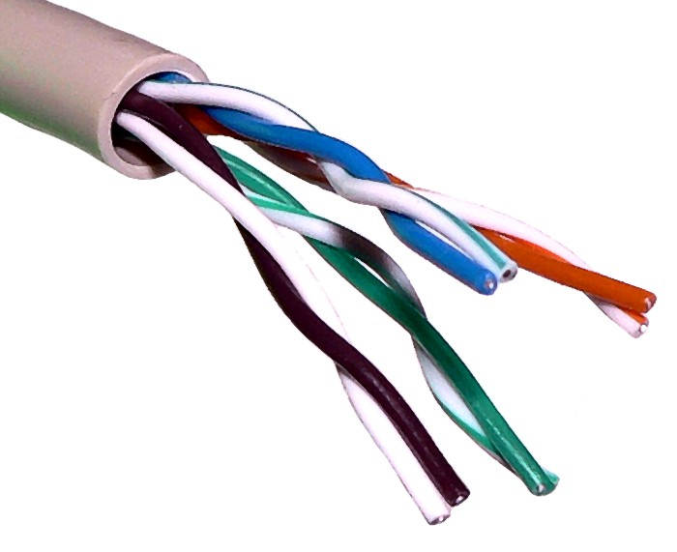
STP (shielded twisted-pair)
has a metal wrapper around each twisted pair wire, which further reduces noise.
UTP (unshielded twisted-pair)
Inexpensive and easy to install
It is usually used in telephone networks

Slide 7
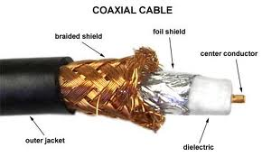
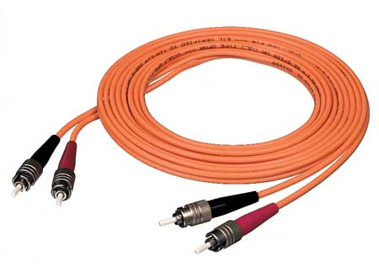
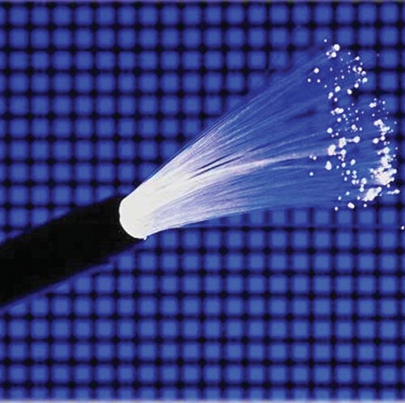
Coaxial Cable
Consist of a single wire surrounded by three layers.(1) an insulating material (2) a woven or braided material (3) a plastic outer coating
Fiber-Optic Cable
Cables that consist of dozen or hundreds of thin strands of glass or plastic that houses light to transmit signals

Slide 8
Wireless transmission media
Include broadcast radio, cellular radio, microwaves, communication satellites and infrared.
Used when it is impractical or impossible to install cables
Uplink from earth station to satellite
Downlink from satellite to earth station

Slide 9
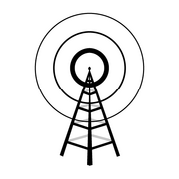
Broadcast Radio
  Long distance
  Station frequencies assigned by FCC (Federal Communications Commission)
    AM
    FM
  Slow
  Susceptible to noise

Slide 10
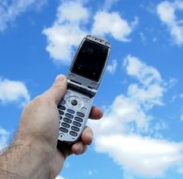
Cellular Radio
  Cellular telephone
    Uses radio signals to transmit voice and digital data messages
  Cells
    Division of broadcast area
    Each covers a specific geographic area and has its own base station
  Mobile telephone switching office (MTSO)
    Sends and receives voice and data traffic to and from the public switched telephone network

Slide 11
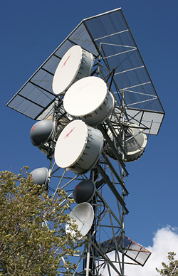
Microwaves
Microwaves
  High-speed
  Microwave stations
    Earth-based reflective dish
  Line-of-sight transmission
    Avoid possible obstructions

Slide 12
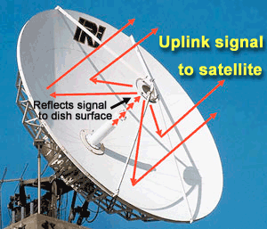
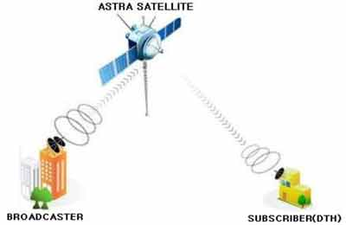
Communication Satellite
  Space station receives signals and re-transmits the signals
    Uplink
    Downlink
  VSAT (Very Small Aperture Terminal)
    Involve transmitting small amounts of data

Slide 13

bluetooth
A proposed radio frequency (RF) specification that many portable devices will use for short-range wireless communications

Slide 14
Infrared (IR)
Infrared (IR) light is electromagnetic radiation with a wavelength longer than that of visible light, measured from the nominal edge of visible red light at 0.74 micrometers (µm), and extending conventionally to 300 µm.

Slide 15
Transmissions Characteristics

Slide 16
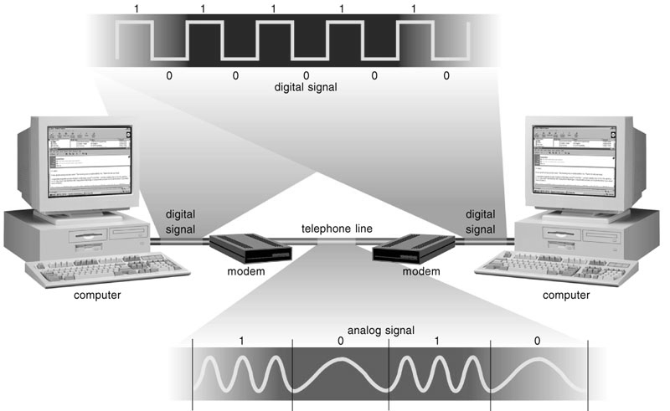
Signal Type
Analog or Digital
  Analog signals are continuous wave
  Digital signals are electrical pulses

Slide 17
Broadband Vs Baseband
  Broadband transmission: The media can transmit multiple signals simultaneously
  Baseband transmission: The media can transmit one signal at a time only

Slide 18
Transmission Modes
Asynchronous Transmission
transmissions are not synchronized - that is, transmission does not occur at predetermined or regular intervals such as when you enter data.
a start bit marks the beginning of the byte and a stop bit marks the end of the byte.
additional bit called a parity bit

Slide 19
Transmission Modes
Synchronous Transmission
involves sending large blocks of bytes at regular intervals without any start/stop signals, such as transmitting a file.
Requires that both the sending and receiving devices be synchronized before any bytes are transmitted.

Slide 20
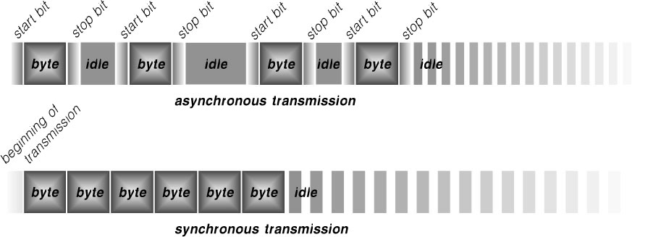

Slide 21
Transmission Directions
Simplex transmission
Data flows only in one direction - from the sending device to the receiving device.
Simplex transmission is used only when the sending device does not require a response from the receiving device.

Slide 22
Transmission Directions
Half-duplex transmission
In half-duplex transmission, data can flow in either direction - from sender to receiver and back - but only in one direction at a time.

Slide 23
Transmission Directions
Full-duplex transmission
data can flow in both directions at the same time.
Full-duplex trans- mission is used for applications with intensive computing requirements or those with heavy traffic.

Slide 24
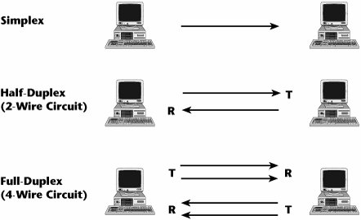

Slide 25
Transfer Rate
The speed with which a transmission medium carries data is its transfer rate.
Transfer rate usually is expressed as bits per second (bps) - that is the number of bits that can be transmitted in one second.

Slide 26
Bandwidth
the range of frequencies that a transmission medium can carry in a given period of time.
analog signals, bandwidth is expressed in hertz (Hz), or cycles per second (cps).
digital signals, bandwidth is expressed in bits per second, or bps.

Slide 27
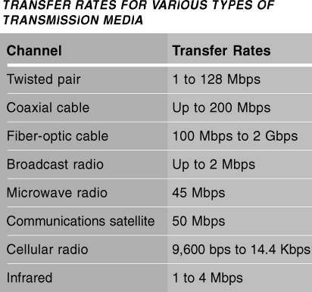

Slide 28
THE TELEPHONE NETWORK

Slide 29
Public Switched Telephone Network (PSTN)
the worldwide telephone system that handles regular voice telephone calls.
service carried by the PSTN is sometimes called plain old telephone service (POTS).
Data, instructions, and information can be sent over the PSTN using dial-up lines or dedicated lines.

Slide 30
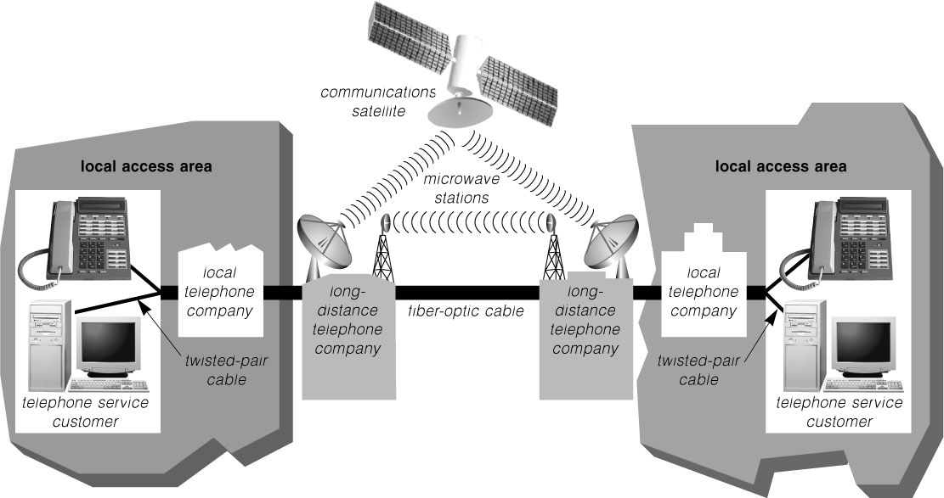

Slide 31
Dial-UP Lines
a temporary connection that uses one or more analog telephone lines for communications.
A dial-up connection is not permanent; each time a call is placed, the telephone company switching offices select the line to use to establish the connection.

Slide 32
Dedicated Lines
a connection that always is established between two communications devices (unlike a dial-up line where the connection is reestablished each time it is used).
dedicated lines provide a constant connection, the quality and consistency of the connection is better than a dial-up line.

Slide 33
Digital Leased Line
ISDN LINES
Integrated Services Digital Network (ISDN) line provides faster transmission rates than regular telephone lines.
a set of standards for digital transmission of data over analog telephone lines.
Basic Rate Interface (BRI) 128 kbps
Primary Rate Interface (PRI) 24 signals

Slide 34
Digital Leased Line
DIGITAL SUBSCRIBER LINES
uses broadband to transmit a greater number of bytes on a standard twisted-pair cable.
Asymmetric DSL downstream rates range from 1.54 Mbps to 8.45 Mbps and upstream rates range from 128 Kbps to 640 Kbps.
Symmetric DSL which is a better choice for longer distances.

Slide 35
Digital Leased Line
T-CARRIER LINES
digital lines that carry multiple signals over a single communications line.
use a technique called multiplexing so that multiple signals can share the telephone line.
1.54 mbps to 43 mbps

Slide 36
ASYNCHRONOUS TRANSFER MODE (ATM)
Asynchronous transfer mode (ATM) is a service designed to carry voice, data, video, and multimedia at high speeds - currently up to 622 Mbps.
Some experts predict that ATM will become the Internet standard for data transmission.

Slide 37
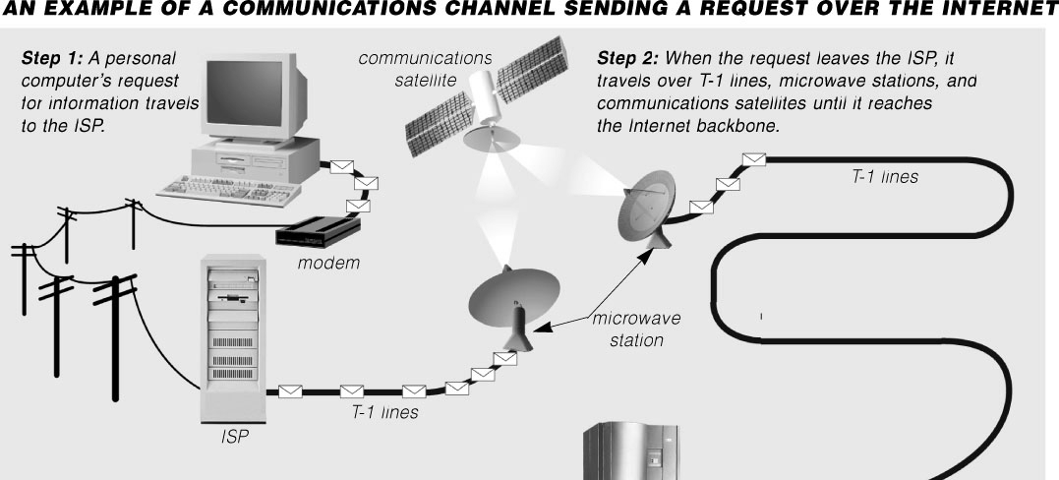

Slide 38
Communication Software

Slide 39
Communication Software
which consists of programs that manage the transmission of data, instructions, and information between computers.
For two computers to communicate, they must have compatible communications software.

Slide 40
COMMUNICATIONS DEVICES
any type of hardware capable of transmitting data, instructions, and information between a sending device (sender) and a receiving device (receiver).
At the sending end, a communications device converts the data, instructions, or information from the sender into signals understood by the transmission media on the communications channel.

Slide 41
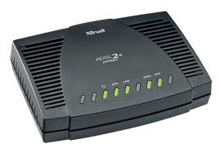
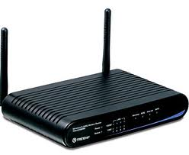
COMMUNICATIONS DEVICES
Modems
derived from a combination of the words, modulate, to change into an analog signal and, demodulate, to convert an analog signal into a digital signal.
external or an internal device

Slide 42
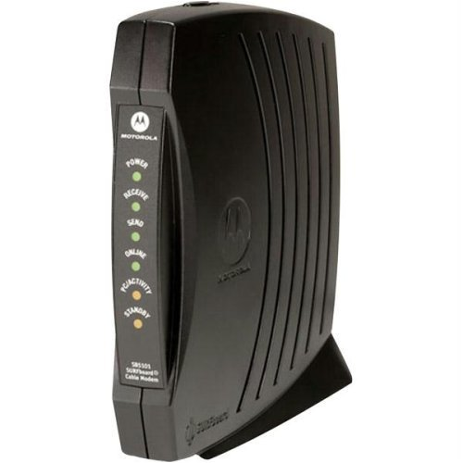
COMMUNICATIONS DEVICES
Cable Modems
a modem that sends and receives data over the cable television (CATV) network, which consists largely of coaxial cable.

Slide 43
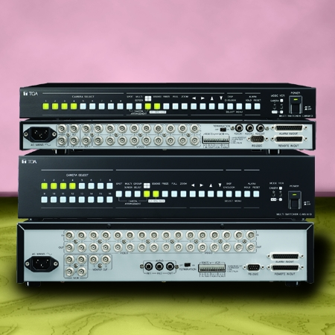
COMMUNICATIONS DEVICES
Multiplexers (MUX)
a device that combines two or more input signals from various devices into a single stream of data and then transmits it over a single transmission medium.
use a technique called multiplexing.

Slide 44
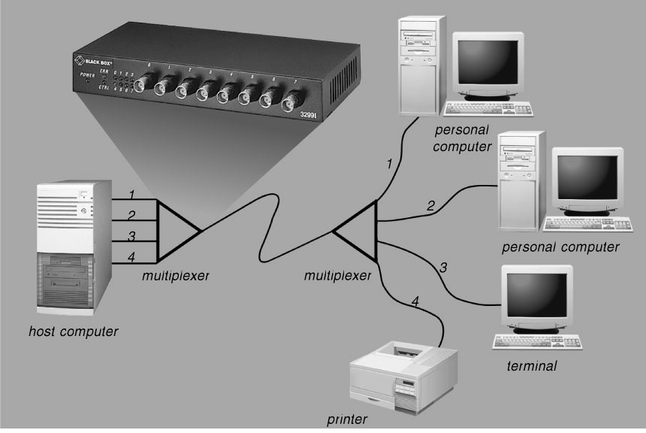

Slide 45
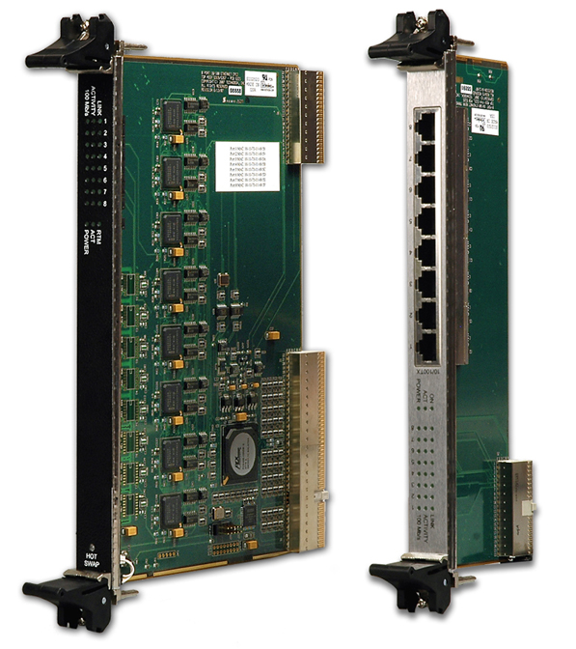
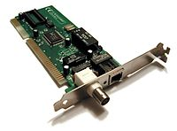
COMMUNICATIONS DEVICES
Network interface Card
Is an expansion card that you insert card into a expansion slot
Coordinates the transmission and receipt of data, instruction and information to and from the computer or device containing the NIC

Slide 46
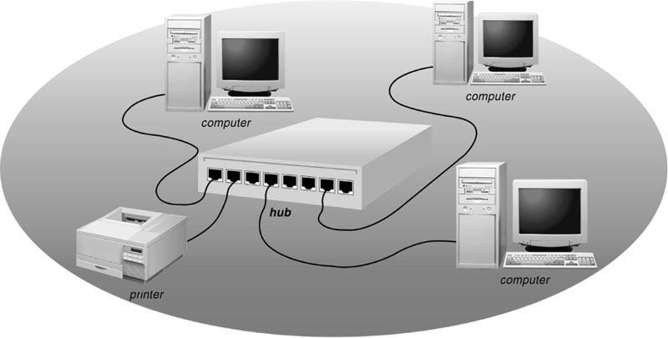
COMMUNICATIONS DEVICES
Hub
also called a concentrator or multi-station access unit (MAU), is a device that provides a central point for cables in a network

Slide 47
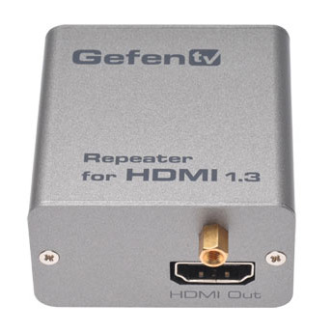
COMMUNICATIONS DEVICES
REPEATER
A repeater is a device that accepts a signal from a transmission medium, amplifies it, and remits it over the medium.
Regenerate analog or digital signals that can be distorted by attenuation

Slide 48
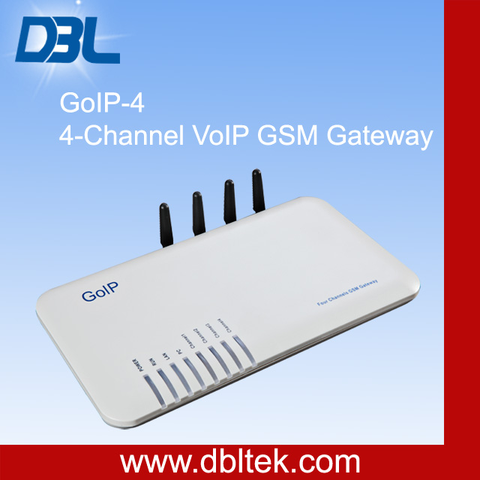
COMMUNICATIONS DEVICES
GATEWAY
a combination of hardware and software that connects networks that use different protocols.

Slide 49
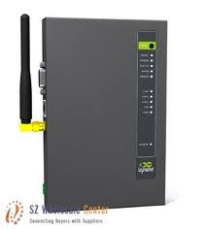
COMMUNICATIONS DEVICES
ROUTER
a device that connects multiple networks – including those with differing protocols.
It is an intelligent communications device that sends (routes) communications traffic to the appropriate work using the fastest available path.

Slide 50
NETWORKS
a collection of computers and devices connected by communications channels that allows users to share data, information, hardware, and software with other users.

Slide 51
NETWORKS
Local Area Network (LAN)
is a network that connects computers in a limited geographical area, such as a school computer laboratory, office, group of buildings.
Two popular types of LANs are peer-to-peer networks and client/server networks.

Slide 52
NETWORKS
Wide Area Network (WAN)
is a network that covers a large geographical area (such as a city or country) using a communications channel that combines telephone lines, microwave, satellites, or other transmission media.

Slide 53
Network Topologies
configuration, or physical arrangement, of the device in a communications network is called network topology or network architecture.

Slide 54
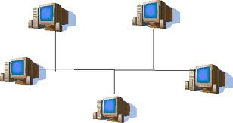
Network Topologies
Bus Topology
A node must be intelligent enough to listen to the bus and recognize own addresses in order to receive incoming data

Slide 55
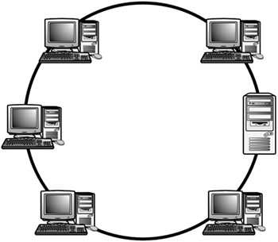
Network Topologies
Ring Network
Intelligent central controller. Each node has an equal amount of intelligence

Slide 56
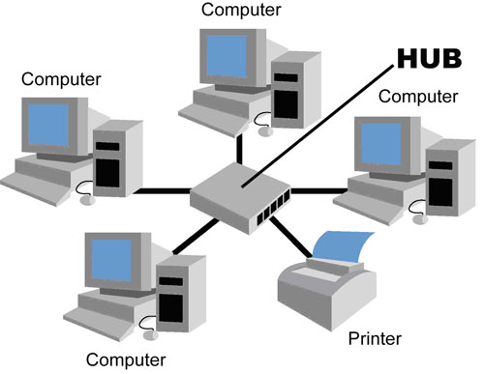
Network Topologies
Star Topology
Intelligent central controller. Each node has an equal amount of intelligence

Slide 57
Protocol
A protocol is a set of rules and procedures for exchanging information among computers.
Using the same protocols, different types and makes of computers can communicate with each other.

Slide 58
Protocol
Ethernet
Ethernet is a LAN protocol that allows personal computers to contend for access to a network.
Token Ring
A token ring protocol controls access to a network by requiring that a special signal called a token is shared or passed among network devices.

Slide 59
Protocol
TCP/IP
TCP/IP (Transmission control protocol/Internet protocol) is a set of protocols used to manage data transmission by breaking it up into packets.

Slide 60
Protocol
Intranets
Intranets are internal networks that use Internet and Web technologies
Intranets make company information accessible to employees and facilitate working in groups.

Slide 61
Protocol
Extranet
An extranet is an intranet that extends to authorized users outside the company.
Extranets facilitate communications among a company’s customers or suppliers.

